Slide 1
Understanding vector calculus

Slide 2
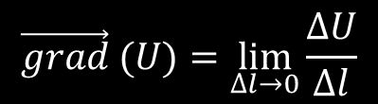

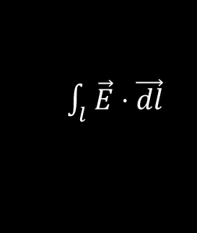
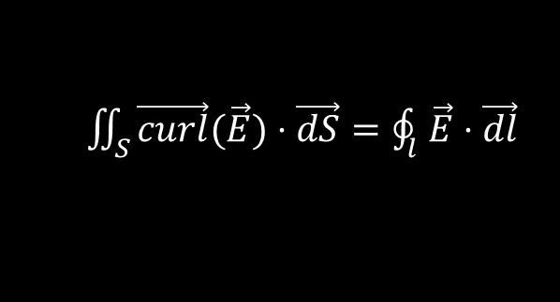

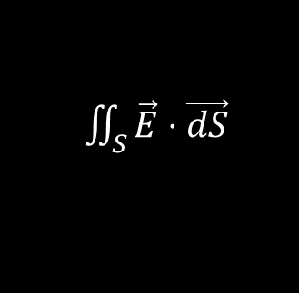
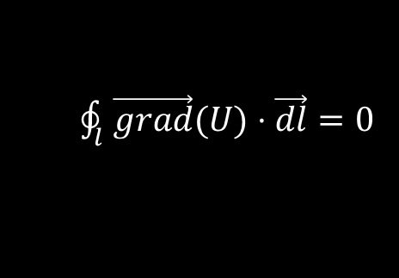
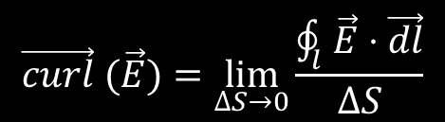
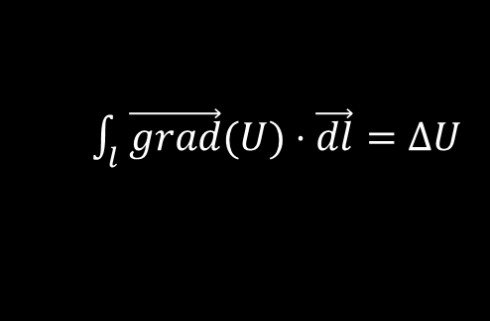
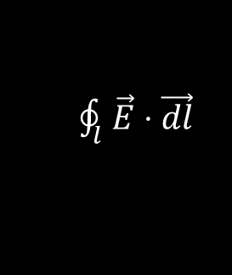
Points
Closed line
$$∆U=U\left(B\right)−U(A)$$
$\oint_{l}^{ }{\vec{E}⋅\vec{dl}}$
$$\vec{grad} (U)=\lim_{∆l→0}{\frac{∆U}{∆l}}$$
$$\vec{curl} (\vec{E})=\lim_{∆S→0}{\frac{\oint_{l}^{ }{\vec{E}⋅\vec{dl}}}{∆S}}$$
$\oint_{l}^{ }{\vec{grad}(U)⋅\vec{dl}}=0$
$\vec{E}=\vec{grad}(U)$ <-> $\vec{curl}(\vec{E})=0$
$\int_{l}^{ }{\vec{E}⋅\vec{dl}}$
$\iint_{S}^{ }{\vec{E}⋅\vec{dS}}$
$\int_{l}^{ }{\vec{grad}(U)⋅\vec{dl}}=∆U$
$\iint_{S}^{ }{\vec{curl}(\vec{E})⋅\vec{dS}}=\oint_{l}^{ }{\vec{E}⋅\vec{dl}}$
Line
Surface

Slide 3

Closed surface integral
$$∯_{S}^{ }{\vec{E}⋅\vec{dS}}$$

Slide 4

Closed surface integral of a curl
$$∯_{S}^{ }{\vec{curl} (\vec{E})⋅\vec{dS}}$$
$$=∮\vec{E}⋅\vec{dl}$$
$$=0$$

Slide 5
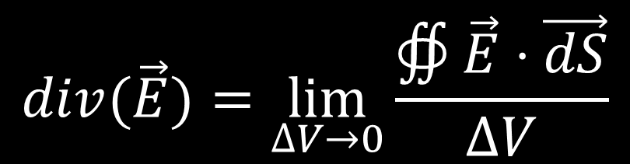
Divergence
$$div(\vec{E})=\lim_{∆V→0}{\frac{∯\vec{E}⋅\vec{dS}}{∆V}}$$

Slide 6




Divergence
$$dz$$
$$div\left(\vec{E}\right)$$
=$\lim_{dxdydz→0}{\frac{−E_{x}dydz+E_{x}\left(x+dx\right)dydz+. . . }{dxdydz}}$
=$\lim_{dxdydz→0}{\frac{E_{x}(x+dx)dydz−E_{x}dydz}{dxdydz}+.. . }$
=$\frac{∂E_{x}}{∂x}+\frac{∂E_{y}}{∂y}+\frac{∂E_{z}}{∂z}$
$$dy$$
$$dx$$

Slide 7


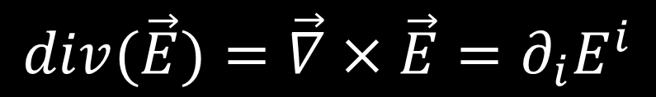
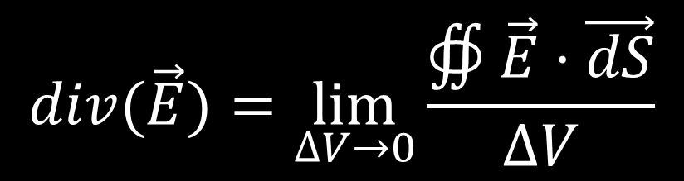

Divergence
$$div(\vec{E})=\lim_{∆V→0}{\frac{∯\vec{E}⋅\vec{dS}}{∆V}}$$
$$dz$$
$$dy$$
$$div(\vec{E})=\vec{∇}×\vec{E}=∂_{i}E^{i}$$
$$dx$$

Slide 8

Divergence of a curl
$$\vec{div}\left(\vec{curl}\left(\vec{E}\right)\right) \\ =\lim_{∆V→0}{\frac{∯\vec{curl}\left(\vec{E}\right)⋅\vec{dS}}{∆V}}$$
$$=0$$
$$dz$$
$$dy$$
$$dx$$

Slide 9

Divergence free fields
$$\vec{div}\left(\vec{E}\right)=0 \\ \vec{E} =\vec{curl}(\vec{F})$$
Only in 3D! No nice geometrical explanation
$$dz$$
$$dy$$
$$dx$$

Slide 10
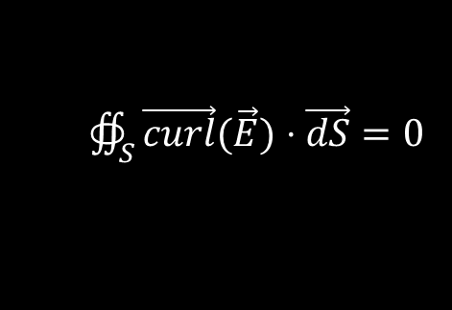
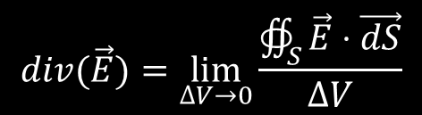
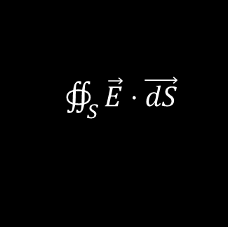
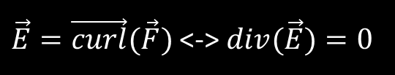
Points
Closed line
Closed surface
$$∆U=U\left(B\right)−U(A)$$
$\oint_{l}^{ }{\vec{E}⋅\vec{dl}}$
$∯_{S}^{ }{\vec{E}⋅\vec{dS}}$
$$\vec{grad} (U)=\lim_{∆l→0}{\frac{∆U}{∆l}}$$
$$\vec{curl} (\vec{E})=\lim_{∆S→0}{\frac{\oint_{l}^{ }{\vec{E}⋅\vec{dl}}}{∆S}}$$
$$div(\vec{E})=\lim_{∆V→0}{\frac{∯_{S}^{ }{\vec{E}⋅\vec{dS}}}{∆V}}$$
$\oint_{l}^{ }{\vec{grad}(U)⋅\vec{dl}}=0$
$∯_{S}^{ }{\vec{curl}(\vec{E})⋅\vec{dS}}=0$
$\vec{E}=\vec{grad}(U)$ <-> $\vec{curl}(\vec{E})=0$
$\vec{E}=\vec{curl}(\vec{F})$ <-> $div(\vec{E})=0$
Only
in 3D!
$\int_{l}^{ }{\vec{E}⋅\vec{dl}}$
$\iint_{S}^{ }{\vec{E}⋅\vec{dS}}$
$\int_{l}^{ }{\vec{grad}(U)⋅\vec{dl}}=∆U$
$\iint_{S}^{ }{\vec{curl}(\vec{E})⋅\vec{dS}}=\oint_{l}^{ }{\vec{E}⋅\vec{dl}}$
Line
Surface

Slide 11
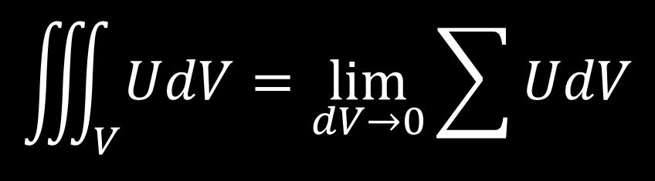
Volume integral
$$\iiint_{V}^{ }{UdV}=\lim_{dV→0}{\sum{UdV}}$$

Slide 12

Volume integral of a divergence
$$\iiint_{V}^{ }{\vec{div} (\vec{E})}dV=$$
$$=\lim_{ΔV→0}{\sum{\frac{∯{\vec{E}⋅\vec{dS}}}{ΔV}ΔV}}$$
$$=\sum{∯{\vec{E}⋅\vec{dS}}}$$
$=$ $∯{\vec{E}⋅\vec{dS}}$

Slide 13
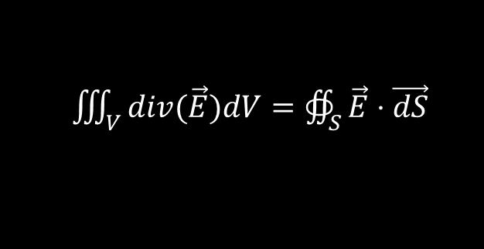
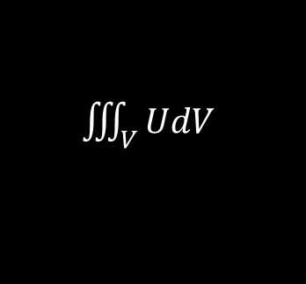
Points
Closed line
Closed surface
$$∆U=U\left(B\right)−U(A)$$
$\oint_{l}^{ }{\vec{E}⋅\vec{dl}}$
$∯_{S}^{ }{\vec{E}⋅\vec{dS}}$
$$\vec{grad} (U)=\lim_{∆l→0}{\frac{∆U}{∆l}}$$
$$\vec{curl} (\vec{E})=\lim_{∆S→0}{\frac{\oint_{l}^{ }{\vec{E}⋅\vec{dl}}}{∆S}}$$
$$div(\vec{E})=\lim_{∆V→0}{\frac{∯_{S}^{ }{\vec{E}⋅\vec{dS}}}{∆V}}$$
$\oint_{l}^{ }{\vec{grad}(U)⋅\vec{dl}}=0$
$∯_{S}^{ }{\vec{curl}(\vec{E})⋅\vec{dS}}=0$
$\vec{E}=\vec{grad}(U)$ <-> $\vec{curl}(\vec{E})=0$
$\vec{E}=\vec{curl}(\vec{F})$ <-> $div(\vec{E})=0$
Only
in 3D!
$\int_{l}^{ }{\vec{E}⋅\vec{dl}}$
$\iint_{S}^{ }{\vec{E}⋅\vec{dS}}$
$\iiint_{V}^{ }{UdV}$
$\int_{l}^{ }{\vec{grad}(U)⋅\vec{dl}}=∆U$
$\iint_{S}^{ }{\vec{curl}(\vec{E})⋅\vec{dS}}=\oint_{l}^{ }{\vec{E}⋅\vec{dl}}$
$\iiint_{V}^{ }{div(\vec{E})dV}=∯_{S}^{ }{\vec{E}⋅\vec{dS}}$
Line
Surface
Volume

Slide 14
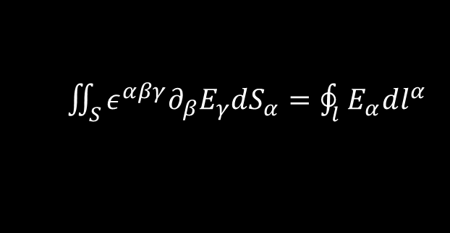
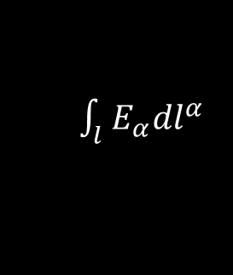
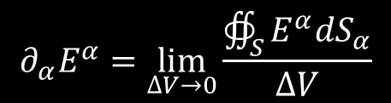
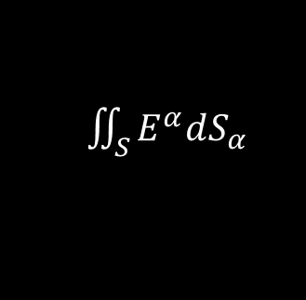

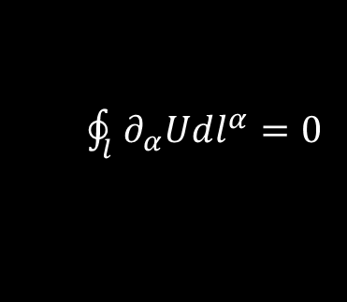
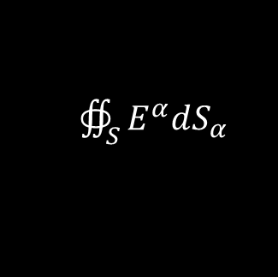
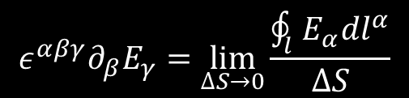
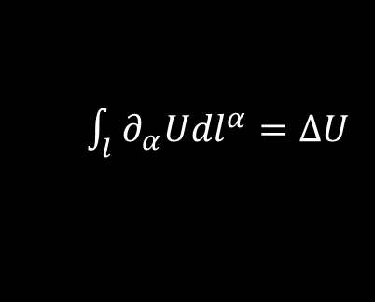

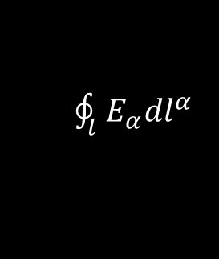

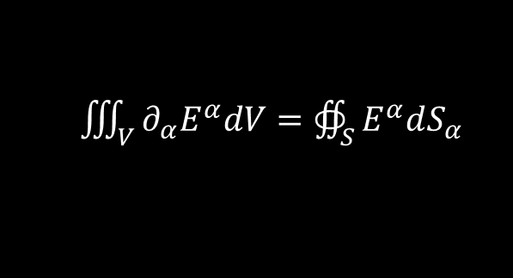
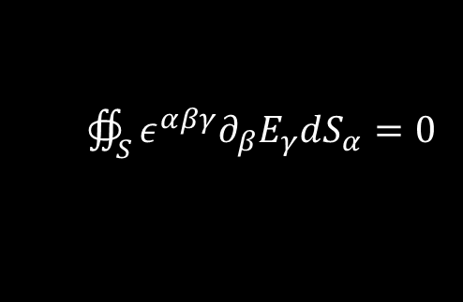
Points
Closed line
Closed surface
$$∆U=U\left(B\right)−U(A)$$
$\oint_{l}^{ }{E_{α}dl^{α}}$
$∯_{S}^{ }{E^{α}dS_{α}}$
$$∂_{α}U=\lim_{∆l→0}{\frac{∆U}{∆l}}$$
$$ε_{}^{αβγ}∂_{β}E_{γ}=\lim_{∆S→0}{\frac{\oint_{l}^{ }{E_{α}dl^{α}}}{∆S}}$$
$$∂_{α}E^{α}=\lim_{∆V→0}{\frac{∯_{S}^{ }{E^{α}dS_{α}}}{∆V}}$$
$\oint_{l}^{ }{∂_{α}Udl^{α}}=0$
$∯_{S}^{ }{ε_{}^{αβγ}∂_{β}E_{γ}dS_{α}}=0$
$E_{γ}=∂_{γ}U$ <-> $ε_{}^{αβγ}∂_{β}E_{γ}=0$
$E^{α}=ε_{}^{αβγ}∂_{β}F_{γ}$ <-> $∂_{α}E^{α}=0$
$\int_{l}^{ }{E_{α}dl^{α}}$
$\iint_{S}^{ }{E^{α}dS_{α}}$
$\iiint_{V}^{ }{UdV}$
$\int_{l}^{ }{∂_{α}Udl^{α}}=∆U$
$\iint_{S}^{ }{ε_{}^{αβγ}∂_{β}E_{γ}dS_{α}}=\oint_{l}^{ }{E_{α}dl^{α}}$
$\iiint_{V}^{ }{∂_{α}E^{α}dV}=∯_{S}^{ }{E^{α}dS_{α}}$
Line
Surface
Volume

